Slide 1
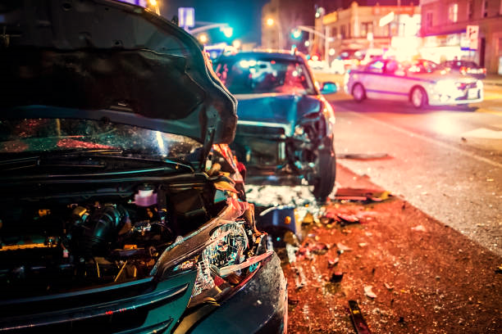
HOT WHEELS
Car Insurance Claim Prediction

Slide 2
CONTENT
01
02
03
About Us
Background & Objectives
Pre-Processing
04
05
06
Insights
Modelling
Summary & Recommendation

Slide 3






ABOUT US
Supervisor
Adam Aditama
Arvian Dwi Revianto
Astri Mardhika Putri S
Abdullah Ghifari
Gadis Vikha Natari
Yusya Trisna M

Slide 4
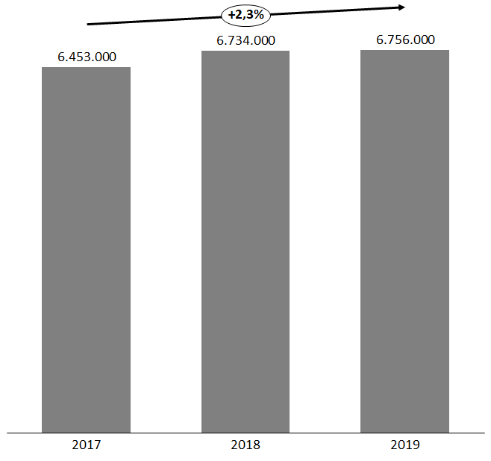
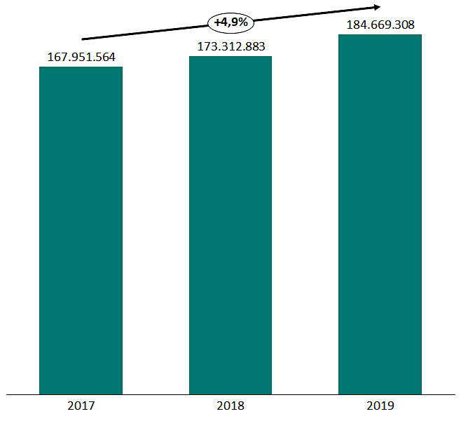
BACKGROUND
Motor Vehicle Crashes
Incurred Losses for Auto Insurance ($000)
Motor Vehicle Crashes in US has increased by 2.3% reaching 6.765.000 cases in 2019.
Increase in accidents, leads to more submission of claim to insurance company.
Auto Insurance Company has suffered from losing money each year and has increased up to 4.9% till 2019.
HOW CAN WE PREVENT THE INSURANCE COMPANY FROM LOSING MONEY?
Sources: https://cdan.nhtsa.gov/tsftables/National%20Statistics.pdf, https://www.iii.org/fact-statistic/facts-statistics-auto-insurance

Slide 5

OBJECTIVES
Goals:
Improve the Company’s lending policies.
Helping companies to manage cash flow, risk exposure, and underwriting system.
Objective:
Predict the likelihood that the customer will file a claim
Business Metrics :
Predict Claim Frequency (%)
Risk Premium ($)

Slide 6
FEATURE OVERVIEW
Customer Attributes | ‘ID’, 'KIDSDRIV’, ‘AGE’, ‘HOMEKIDS’, ‘YOJ’, ‘INCOME’, ‘PARENT1’, ‘HOME_VAL’, ‘MSTATUS’, ‘GENDER’, ‘EDUCATION’, ‘OCCUPATION’
Car Attributes | ‘TRAVTIME’, ‘CAR_USE’, ‘BLUEBOOK’, ‘CAR_TYPE’, ‘RED_CAR’, ’CAR_AGE’, ‘MVR_PTS
Insurance Attributes | ‘OLDCLAIM, ‘CLM_FREQ’, ‘REVOKED’
Target Feature | ’CLAIM_FLAG’, ’CLM_AMT’
The dataset consists of 10,302 data where there are still missing values, data duplicates, and outliers.

Slide 7
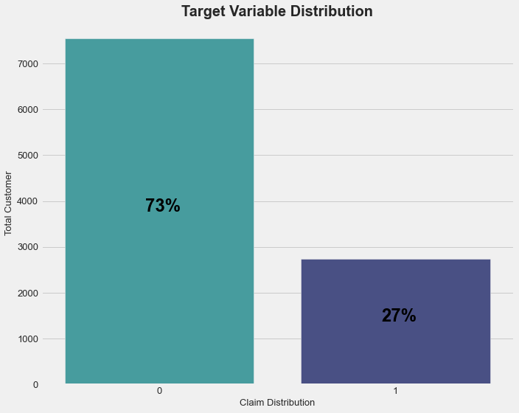
FEATURE TARGET
7556
Count Policy by Claim Flag.
Grouping Claim Amount by Claim Flag.
‘CLAIM_FLAG’ | ‘CLM_AMT’ (in USD)
 | SUM | MIN | MEAN | MAX
CLAIM ‘NO’ | 0 | 0 | 0 | 0
CLAIM ‘YES’ | 15,569,067 | 30 | 5,669.73 | 123,247
2746
The value of ‘CLM_AMT’ is highly correlated to the target variable ‘CLAIM_FLAG’, that means ‘CLM_AMT’ is also a dependent variable to the target variable.
CLAIM ‘NO’
CLAIM ‘YES’
The target variable ‘CLAIM_FLAG’ shows that 2746 (27%) customers make a claim and 7556 (73%) customers do not make a claim.

Slide 8
DATA PRE-PROCESSING
Data Cleansing
Normalization / Standardization
We filled the missing values using KNN-Imputer method for features ‘AGE’, ‘YOJ’, ‘INCOME’, ‘HOME_VAL’, ‘OCCUPATION’, ‘CAR_AGE’, and dropped data duplicates.
We normalized features ‘AGE’, ‘YOJ’, ‘INCOME’, ‘TRAVTIME’, ’BLUEBOOK’ and ‘CAR_AGE’ that tend to have normal distribution.
The other features are normalized.
Feature Encoding
Imbalance Treatment
Performed one hot encoding for features ‘PARENT1’, ‘MSTATUS’, ‘GENDER’, ‘RED_CAR’, ‘REVOKED’
We have used all the balancing method, such as UnderSampling, OverSampling, and SMOTE.

Slide 9
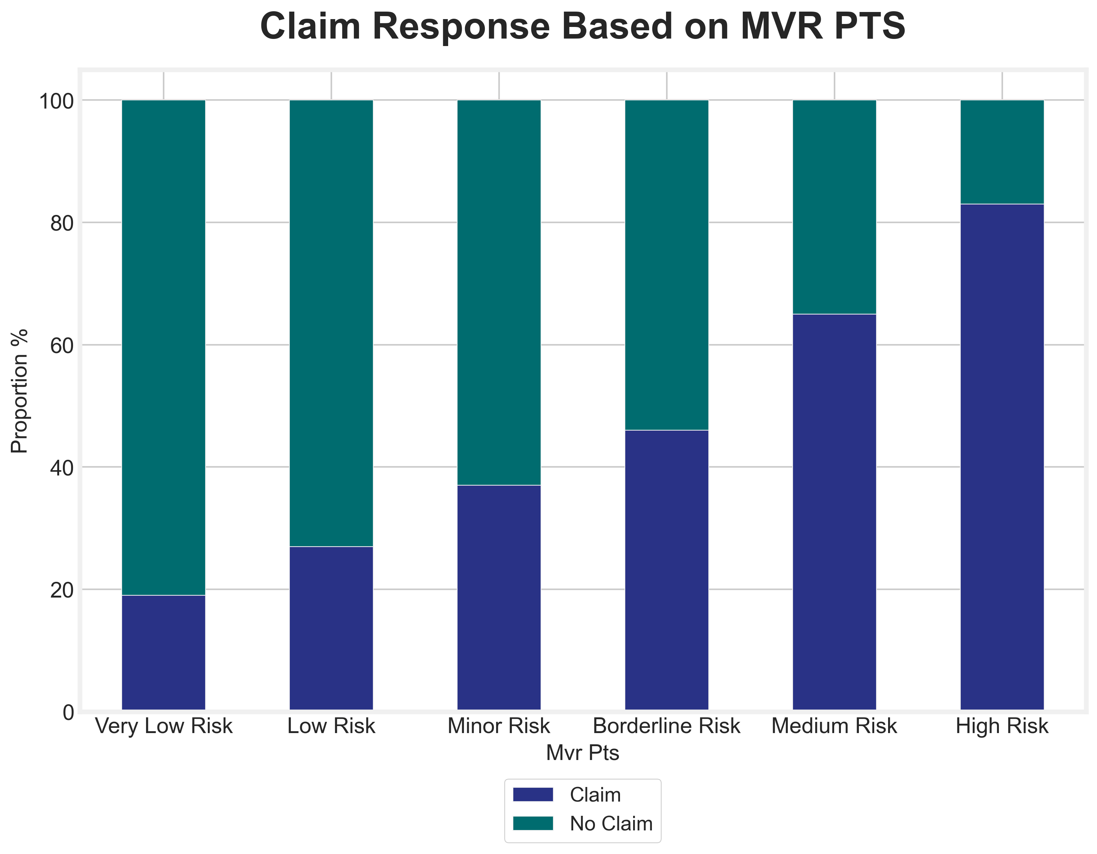
INSIGHTS
MVR_PTS is Motor Vehicle Road Points which define an individual’s past driving history indicating violations and accidents over a specific period, with distribution of categories as follow:
Very Low Risk : 0 pts
Low Risk : 1-3 pts
Minor Risk : 4-5 pts
Borderline Risk : 6-7 pts
Medium Risk : 8-9 pts
High Risk : +10 pts
The higher the MVR_PTS, the greater the tendency of customers to make claims.
17%
34%
54%
63%
81%
73%
84%
65%
46%
37%
19%
27%
https://www.wnins.com/losscontrolbulletins/MVREvaluation.pdf

Slide 10
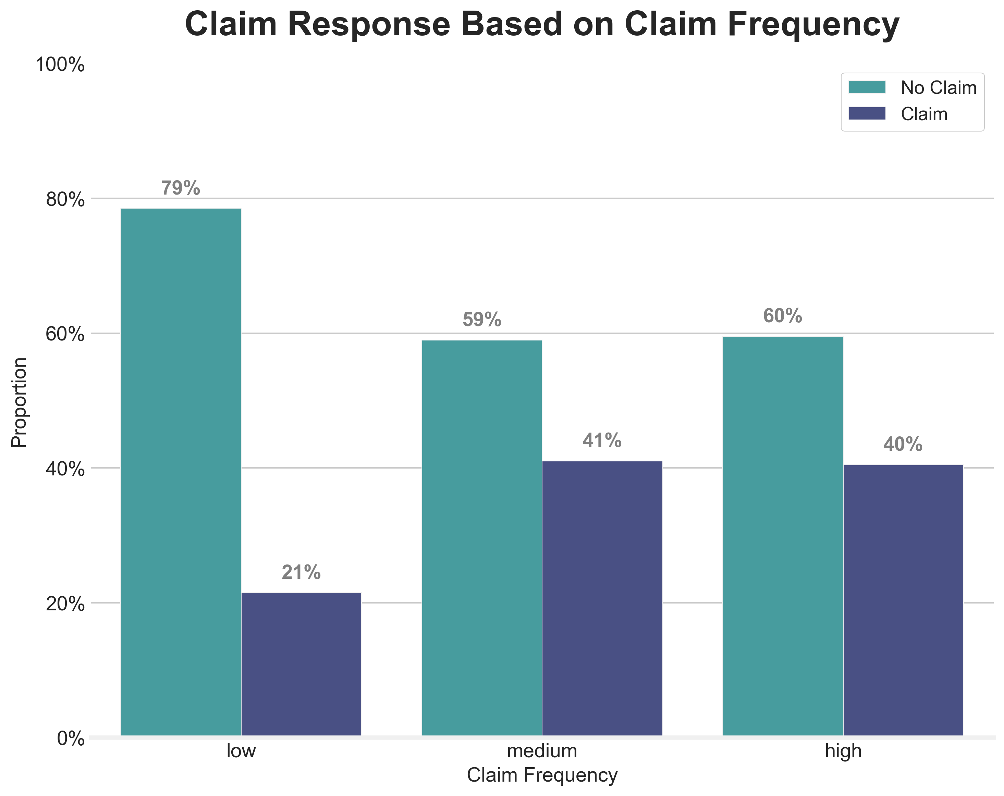
INSIGHTS
CLAIM FREQUENCY
Low : 0 - 1
Medium : 2 - 3
High : 4 - 5
Customers who had done claim for several time, they have the tendency to make a claim again.

Slide 11
MODELING EXPERIMENTS
Evaluation
K-Nearest Neighbors
Logistic Regression
Decision Tree
Random Forest
AdaBoost
XG Boost
F1 - Score

Slide 12
MODELING RESULTS
Model | Sample Methods | F1-Score (before Hypertuning) | F1-Score (after (Hypertuning)
KNN | SMOTE | 0.48 | 0.43
 | Over Sampling | 0.23 | 0.19
 | Under Sampling | 0.18 | 0.36
Logistic | SMOTE | 0,55 | 0,55
 | Over Sampling | 0,48 | 0,48
 | Under Sampling | 0,48 | 0,48
Decision Tree | SMOTE | 0,41 | 0,49
 | OverSampling | 0,41 | 0,39
 | UnderSampling | 0,42 | 0,48
Random Forest | SMOTE | 0,52 | 0,53
AdaBoost | SMOTE | 0,55 | 0,55
XGBoost | SMOTE | 0,52 | 0,48
We use F1-Score because we have an extreme data imbalance between positive and negative samples also we consider the fraction of the positively labeled sample that is correctly labeled. And we don't consider the purity of the sample labeled as negative (the specificity).
From the modelling, we choose Logistic Regression as our model because it has the best F1-Score among all methods and value of Recall is 0.71.

Slide 13
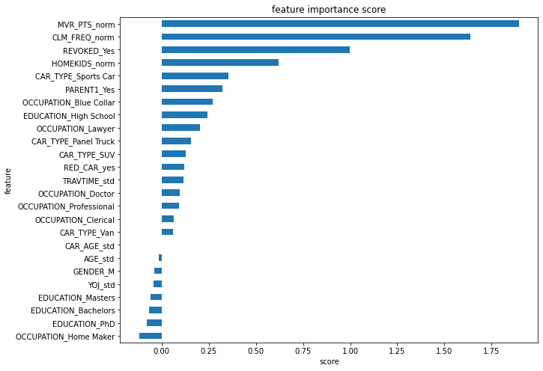
FEATURE IMPORTANCES

Slide 14





BUSINESS SIMULATION BEFORE MODELLING
2,746 Claim
Amount Claim: USD15,569,067
Annual Premium Rate:
USD1,470*
Total Revenue from Premium:
USD 15,143,940
Total Losses
USD 425,127
10,302 policy
7,556 No Claim
*Source: https://www.thezebra.com/state-of-insurance/auto/2019/#download

Slide 15
BUSINESS SIMULATION AFTER MODELLING
2,746 Claim
Amount Claim: USD15,569,067
After modelling, we can predict that 1,950 will claim.
These 1,950 are considered high risk driver and will be given higher premium (25% more than normal premium rate*)
8,352 will use normal premium rate and 1,950 will be given higher risk premium rate
Normal Premium Rate:
USD 1,470
Higher Risk Premium Rate:
USD 1,838
Total Revenue from Premium:
USD 15,861,540
10,302 policy
Total Income
USD 292,473
7,556 No Claim
*Source: https://www.thebalance.com/what-is-a-high-risk-driver-527253

Slide 16
IMPACTS
Before Modelling
After Modelling
Total Losses
USD425,127
Total Income
USD 292,473

Slide 17


SUMMARY & RECOMMENDATION
This machine learning can classify which customers have the tendency to file the insurance claim, so that later evaluation of existing insurance policies can be carried out.
Recommendations:
Customers who tend to file claims will be given a higher premiums than customers who do not file claims (CLM_FREQ).
Consumers will be given attractive promos if they can drive safely, and can reduce violations and accidents over a specific period (MVR_PTS).

Slide 18
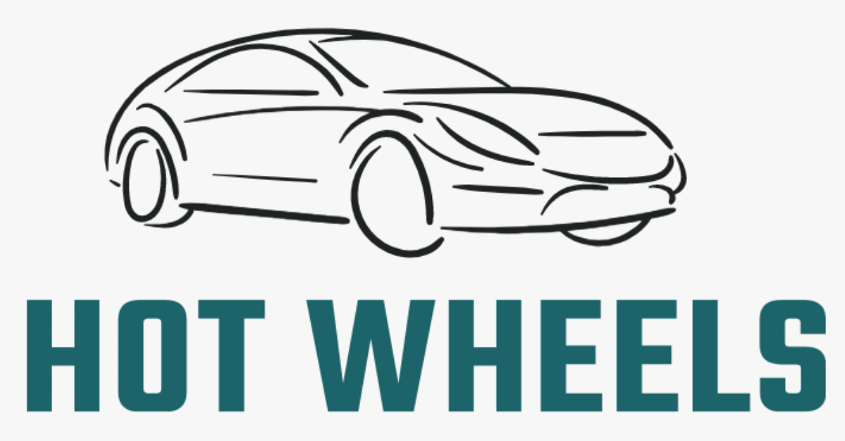
THANK YOU

